Slide 1

ASOS
RMIT – Data Science Strategy and Leadership
Consumer Analytics
Assignment 3
Link to the video presentation: https://www.loom.com/share/f18d53c39b3d43178b6d850a22c052b3
Hassan Ismail
S3823277
20 Aug 2020

Slide 2
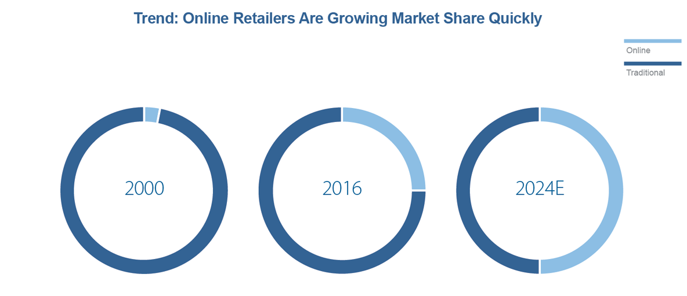
ASOS
An online Fashion retailer
Vision
Become the world's number-one destination for fashion-loving 20-somethings.
Be unique, multi-platform experience that truly resonates with the people who use it, because it's built by them. It's a place to develop your own style and be inspired… and, of course, to shop.
Young adults (16-34 years old) men and women
Highly interested in Fashion
Digital natives
Mission
Target

Slide 3
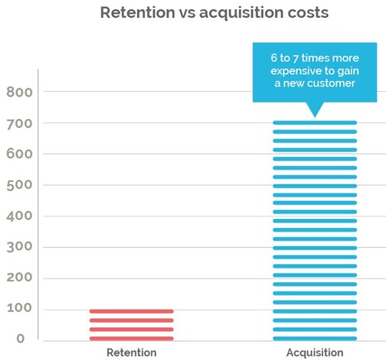
The Issue
The Company is facing a margin erosion.
The decrease in the profit margin in our case is due to:
Decreasing retention rate within 15-24 age group in the last two years.
Decreased market share.
Low Average Order Value.

Slide 4

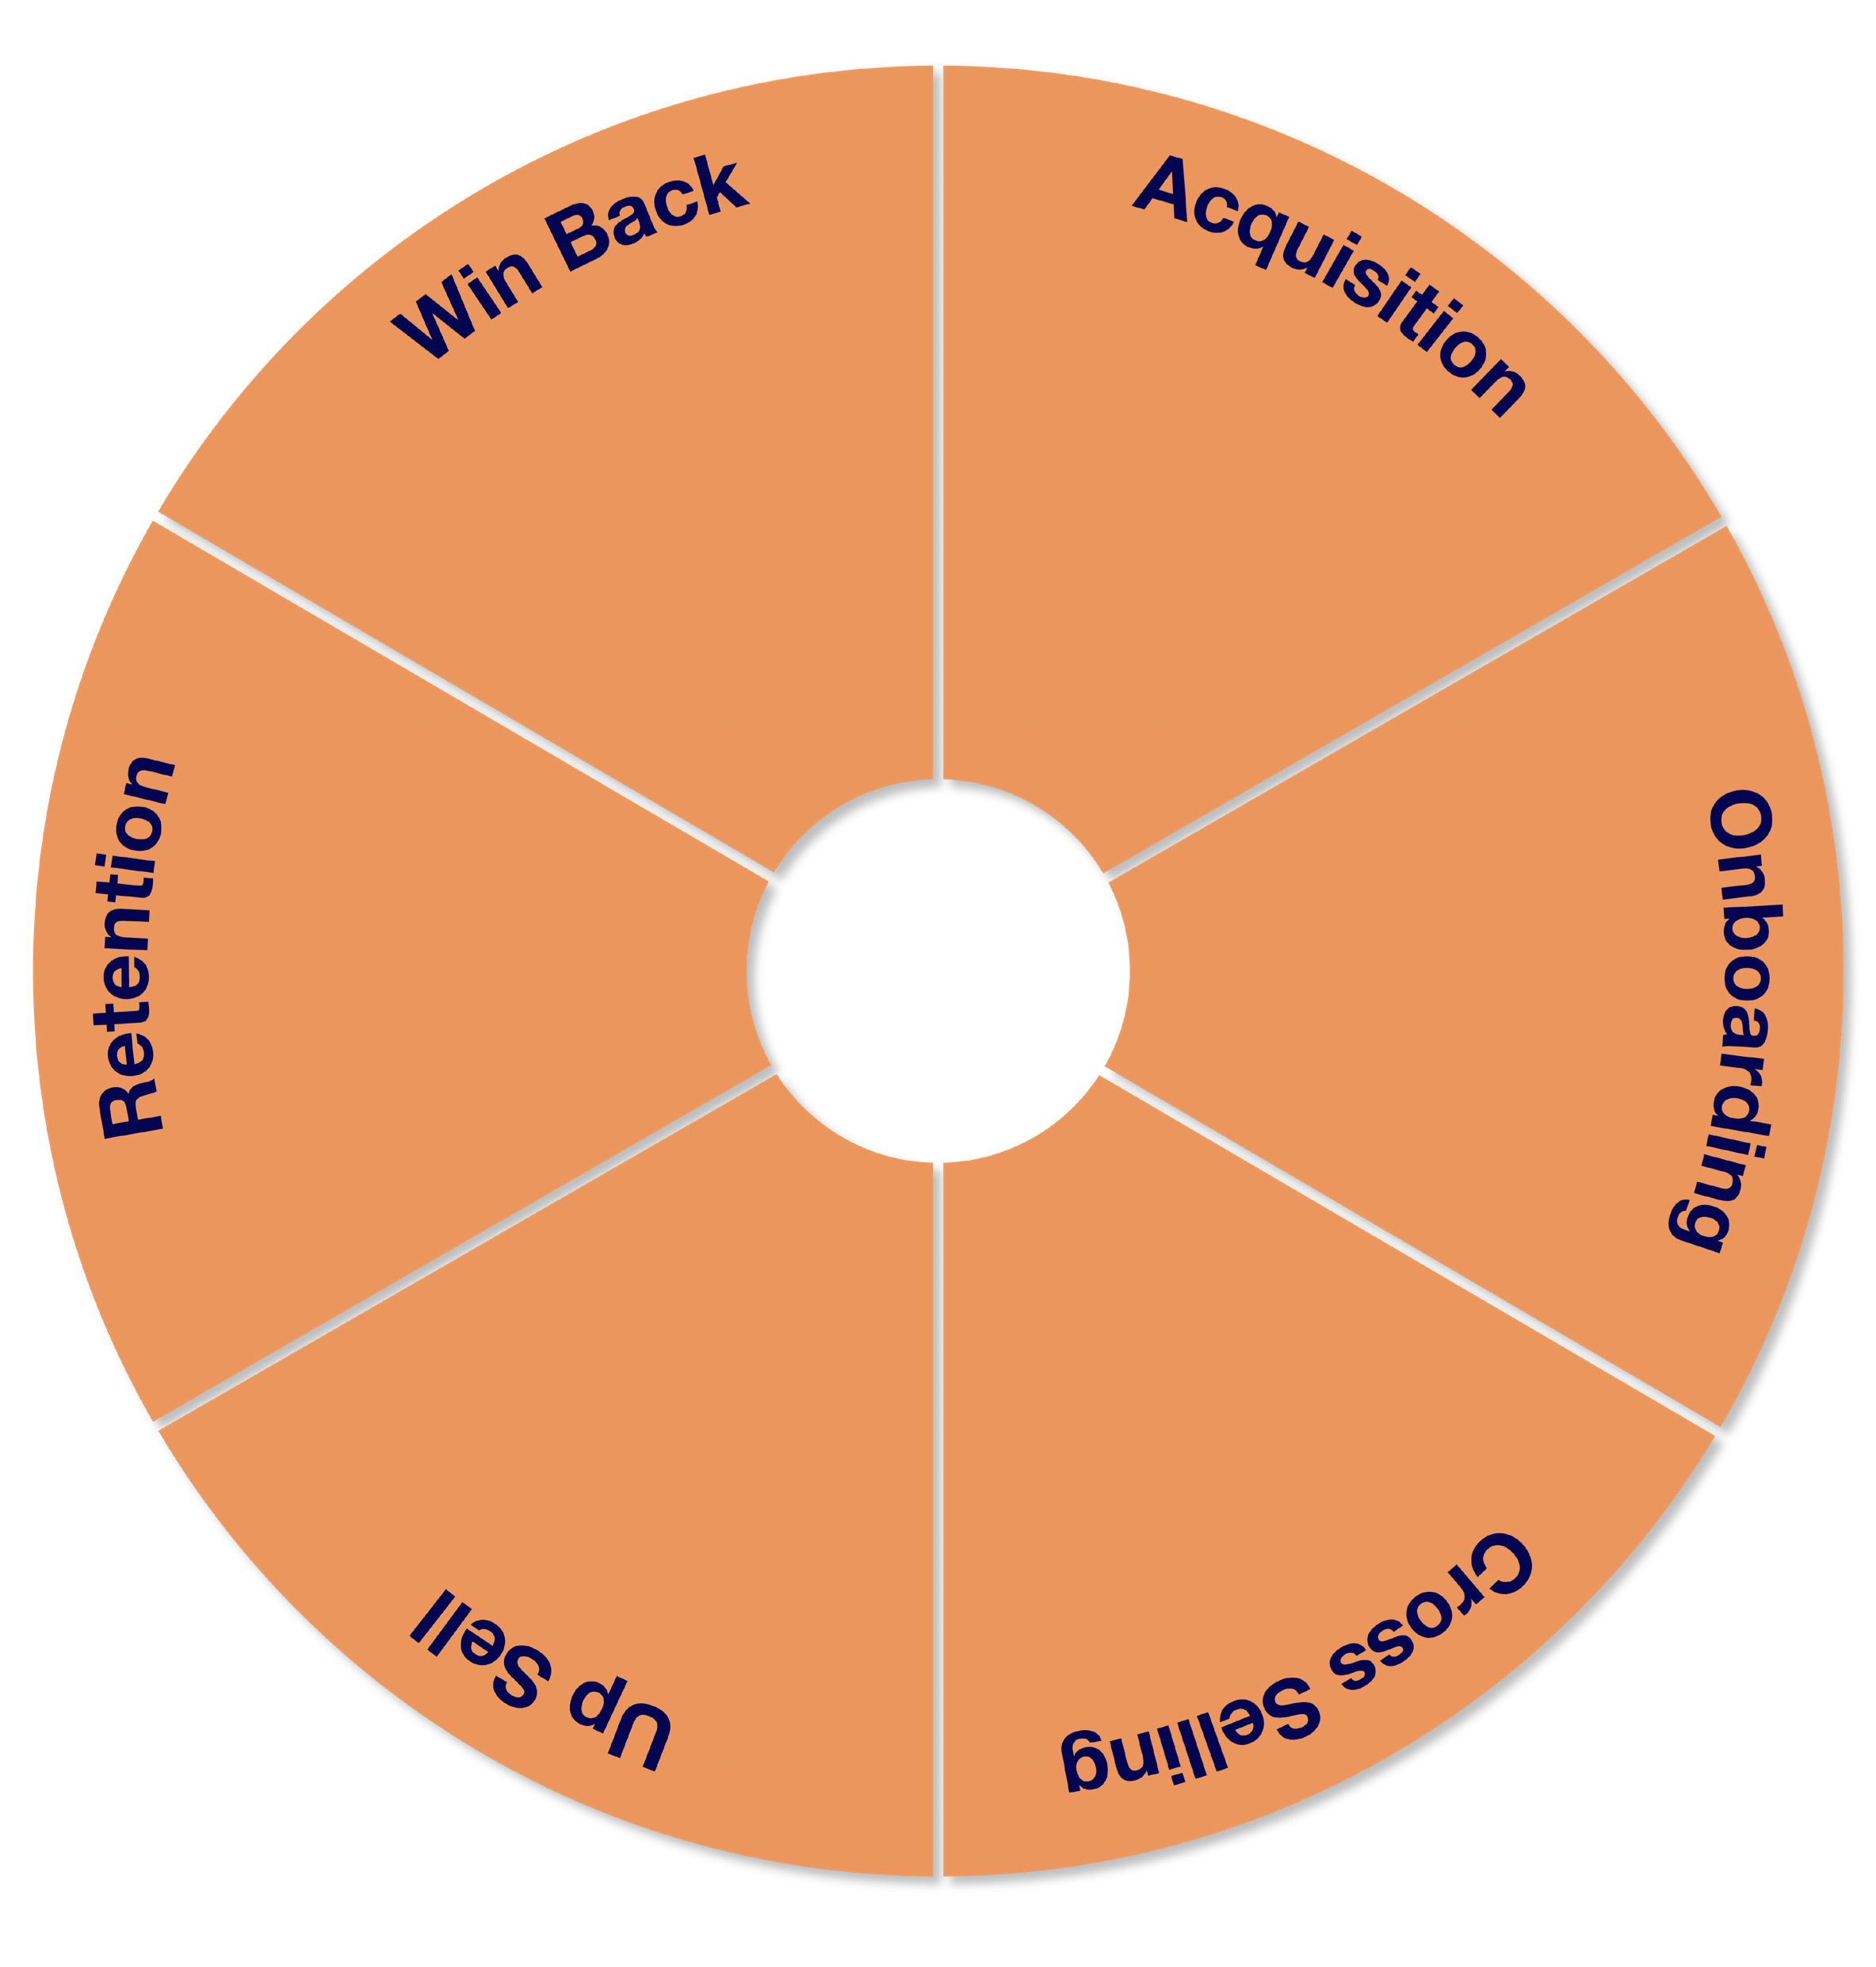


Consumer Friction Point
The stop/transform of the loyalty program impacted the retention rate and the consumer experiences.
Unhappy costumers will start looking somewhere else to purchase their needs

Slide 5
The Solution
Objectives
Solutions
Increase Consumer Retention rate
Focus on Segmentation and Personalisation
Increase/maintain Market Share
Up-sell and cross-sell
Recommendation Systems
Increase Average Order Value

Slide 6
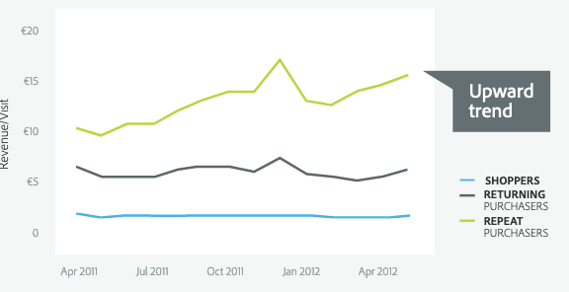
Segmentation and Personalisation
Increase Consumer Retention rate
Increase/maintain Market Share
Up-sell and cross-sell
Apply Segmented regression model on current customers and focus on age group (15-24) to predict the customers who are more likely to be defect.
Input: Current consumers: Age, city, suburb, education, gender, type of purchases.
Output: Predicted purchase value for next period (year)
Classify the new customers and focus marketing on returning and repeat purchasers (k-Nearest Neighbours).
Input: New purchaser data.
Output: Class of the new purchaser (shopper, returning purchaser, repeat purchaser).

Slide 7
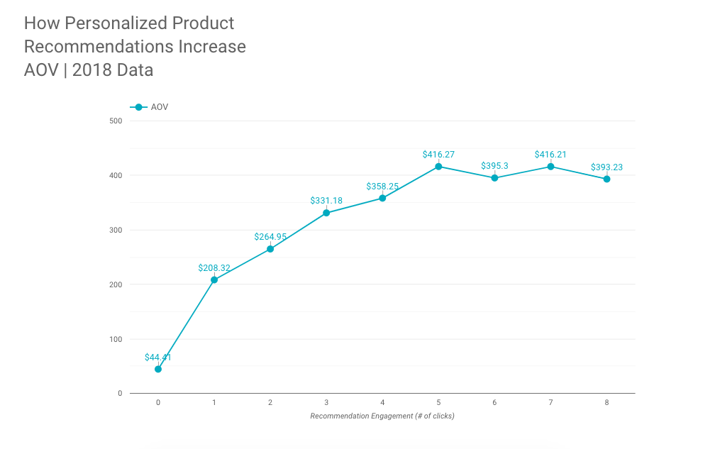
Recommendation Systems
Up-sell and cross-sell
Increase Average Order Value
Build a Recommendation Engine:
Input: Historical customer and purchases data.
Output: Recommend a new suitable and useful to consumers.

Slide 8
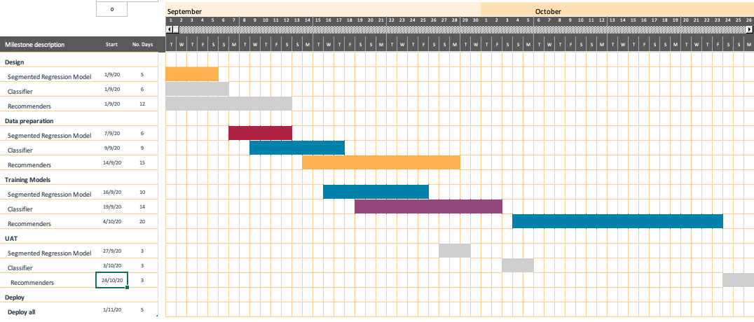
Timeline

Slide 9
KPI, Risks, Assumptions
Success Measures:
Repeat purchase probability (RPP): Increase of 20% by 6 months.
Average Order Value (AOV): Increase by 30% by 4 months.
Consumer Retention Rate: Increase by 50% by 1 year.
Assumptions:
Enough Available data inhouse.
Data is clean and reliable.
Risks:
In-house data is not enough: accept the risk.
Data is not clean - Mitigation: extend data preparation time and resource.

Slide 10
References
Adobe : The ROI from Marketing to Existing Online Customers http://success.adobe.com/assets/en/downloads/whitepaper/13926.digital_index_loyal_shoppers_report.pdf
Strategic Data Driven Approach to Improve Conversion Rates and Sales Performance of E-Commerce https://www.citefactor.org/journal/pdf/Strategic-Data-Driven-Approach-to-Improve-Conversion-Rates-and-Sales-Performance-of-E-Commerce-Websites.pdf
Customer Retention in On-line Retail
http://www.icommercecentral.com/open-access/customer-retention-in-online-retail.pdf
Tips for Effective Personalized Product Recommendations
https://www.barilliance.com/personalized-product-recommendations-stats/

Slide 11

THANK YOU

